Slide 1
Agile Development

Slide 2
Extreme Programming (XP)
The most widely used agile process, originally proposed by Kent Beck
Defines a set of five values that establish a foundation for all work in XP
  Communication
  Simplicity
  Feedback
  Courage
  Respect
1

Slide 3
Extreme Programming (XP)
The most widely used agile process, originally proposed by Kent Beck
XP Planning
  Begins with the creation of “user stories”
  Agile team assesses each story and assigns a cost
  Stories are grouped to form a deliverable increment
  A commitment is made on delivery date
  After the first increment “project velocity” is used to help define subsequent delivery dates for other increments

Slide 4
Extreme Programming (XP)
Example user stories
Students can purchase monthly parking passes online. Parking passes can be paid via credit cards. Parking passes can be paid via PayPal. Professors can input student marks. Students can obtain their current seminar schedule. Students can order official transcripts. Students can only enroll in seminars for which they have prerequisites. Transcripts will be available online via a standard browser.

Slide 5
Extreme Programming (XP)
XP Design
  Follows the KIS principle
  Encourage the use of CRC cards (Class Responsibility Collaborator)
  For difficult design problems, suggests the creation of “spike solutions”—a design prototype
  Encourages “refactoring”—an iterative refinement of the internal program design
XP Coding
  Recommends the construction of a unit test for a store before coding commences
  Encourages “pair programming”
XP Testing
  All unit tests are executed daily
  “Acceptance tests” are defined by the customer and excuted to assess customer visible functionality

Slide 6
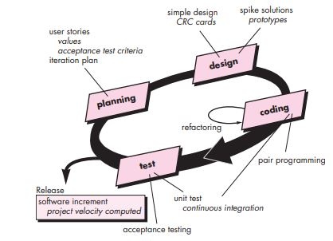
Extreme Programming (XP)

Slide 7
Scrum
Originally proposed by Schwaber and Beedle
Scrum—distinguishing features
  Development work is partitioned into “packets”
  Testing and documentation are on-going as the product is constructed
  Work occurs in “sprints” and is derived from a “backlog” of existing requirements.
  Meetings are very short and sometimes conducted without chairs.
  “demos” are delivered to the customer with the time-box allocated.

Slide 8
